Slide 1
Problems, Problem Spaces, and Search

Slide 2
To Solve a problem….
Define the problem precisely.
Analyze the problem.
Isolate and represent the task knowledge that is necessary to solve the problem.
Choose the best problem-solving technique and apply it to the particular problem.

Slide 3
Defining the problem as State Space Search
Consider the problem “Play Chess”.
For solving the problem, specify:
- The starting position of the chess board.
- Rules that define legal moves.
- Board position that represents a win for
either side.
Goal: Any board position in which the opponent does not have a legal move and king is under attack.

Slide 4
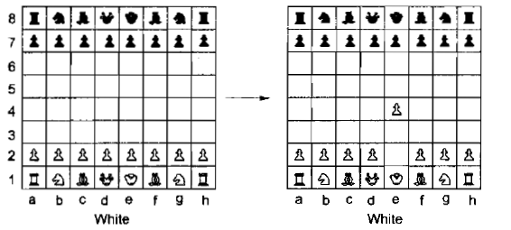
A Legal Move

Slide 5
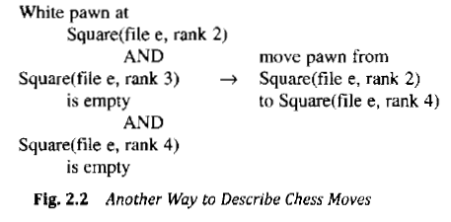
Legal Move…
Provides a way of getting from initial state to final state.
Consists of two parts: left side contains a pattern to be matched against current board position and right hand side the changes to board position to reflect the move.

Slide 6
Problem of “Play Chess” is thus defined as….
Moving around in state space.
Each state consists of a legal position of the board.
Consists of an initial state, a set of rules for moving from one state to other and ending up in one of the final states.

Slide 7
Water Jug Problem
Given two jugs of 4 gallon and 3 gallons without measuring markers.
Pump to fill the jugs with water.
How can you get exactly 2 gallons of water into the 4 gallon jug?

Slide 8
State space defined as set of ordered pairs (x, y), where x=0,1,2,3 or 4 and y=0,1,2 or 3, x represents the number of gallons of water in the 4 gallon jug and y represents the number of gallons of water in the 3 gallon jug.
Start state is (0,0).
Goal state is (2,n).

Slide 9
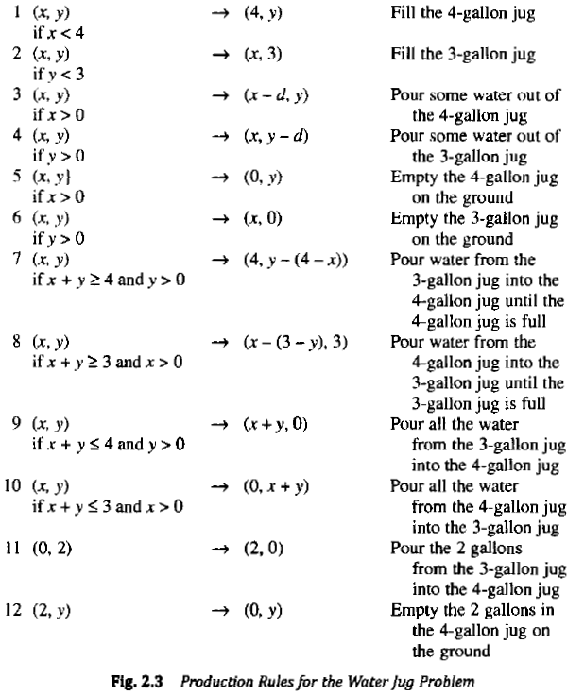

Slide 10
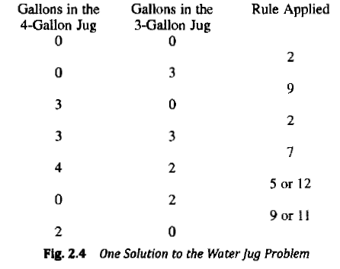

Slide 11
In order to provide a formal description of the problem:
1. Define a state space that contains all the possible configurations of the relevant objects.
2. Specify the initial state.
3. Specify the goal states.
4. Specify a set of rules that describe the actions (operators) available.

Slide 12
Production Systems
Are structures in AI programs for facilitating description and performing search process.
A production system consists of
- A set of rules.
- One or more knowledge bases containing information appropriate to a particular task.
- A control strategy specifying the order in which rules are chosen.
- A rule applier.

Slide 13
Control Strategies
1. The first requirement of a good control is that it causes motion.
Ex: Starting each time at the top of the list of rules and choosing the first applicable one.
2. The second requirement of a good control strategy is that it be systematic.
Ex: On each cycle, choose at random from among the applicable rules.

Slide 14
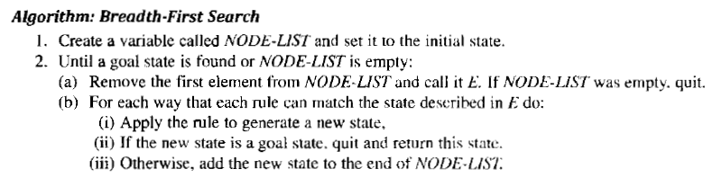

Slide 15
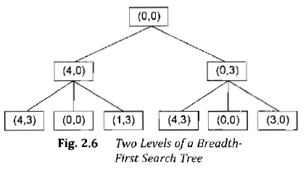
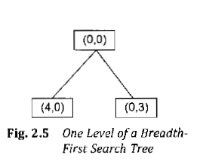

Slide 16
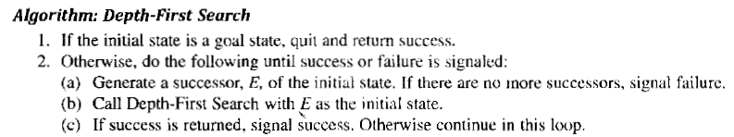

Slide 17
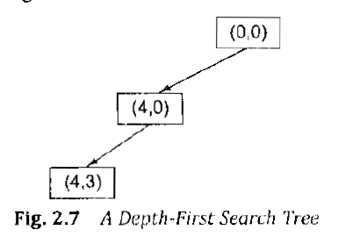

Slide 18
Advantages of DFS
1. DFS requires less memory since only the nodes on the current path are stored.
2. By chance or otherwise DFS may find a solution without examining much of the search space at all.

Slide 19
Advantages of BFS
BFS will not get trapped in a blind alley in contrast to DFS.
If there is a solution BFS is guaranteed to find it. Further if there are multiple solutions BFS is guaranteed to find the optimal of them.

Slide 20
The Travelling Salesperson Problem
A salesman has a list of cities which he must visit exactly once.
There are direct routes between each pair of cities.
Find the route that should be followed so that the distance covered should be minimal.
The number of possible paths are explored between N cities is (N-1)!.
This is called combinatorial explosion.

Slide 21
Heuristic Search
Used for solving difficult problems.
Compromise mobility and systematicity.
Does not always find the best answer but always finds a very good answer.
Example: Nearest Neighbor Heuristic for solving TSP.
Time complexity: order of N².

Slide 22
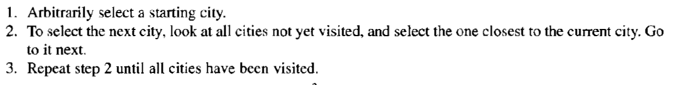

Slide 23
Heuristics improves upon the solution to the problem by removing combinatorial explosion.
Other advantages are:
- Rarely do we need optimal solution. A good approximation usually serves very well.
Ex: Parking space.
- Heuristics may not produce best results in worst cases but worst cases hardly arise in real world.
-Leads to better understanding of the problem.

Slide 24
Heuristic Function
Is a function that maps from problem state description to measures of desirability, usually represented as real numbers.
Plays an important role in guiding the search process towards a solution.
Example: For a TSP the sum of distances so far.

Slide 25
Problem Characteristics
Heuristic Search –a very general method applicable to large class of problems.
Consists of a wide variety of techniques which are applicable based on problem domain.
For this problems are to be analyzed along key dimensions.

Slide 26
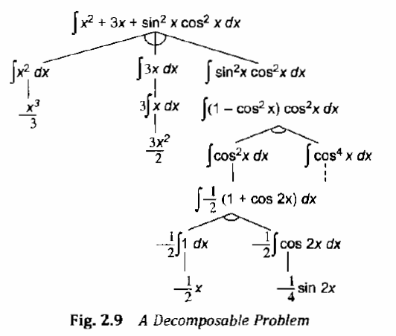
Is the Problem decomposable?

Slide 27
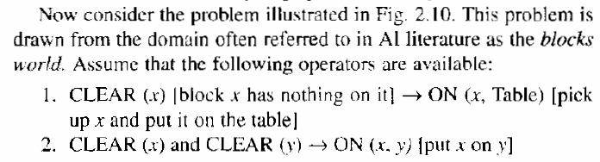
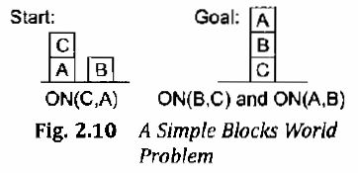
Blocks World

Slide 28
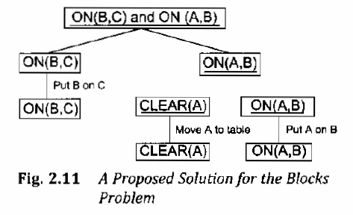

Slide 29
Can Solution Steps be ignored or Undone?
Suppose we are trying to prove a mathematical theorem. Every time we make a mistake we can ignore and correct it.
Suppose we are trying to solve the 8-puzzle problem. If we make a mistake we can backtrack and solve it.
Now consider the game of chess. If a bad move is made it cannot be undone or backtracked.

Slide 30
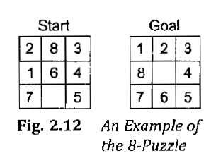

Slide 31
There are thus three class of problems:
- Ignorable, in which solution steps can be ignored. It can be solved by a simple control structure that never backtracks.
- Recoverable, in which solution steps can be undone. Backtracking is necessary to recover from errors.
- Irrecoverable, in which solution steps cannot be undone. These system take a lot of time for the planning process.

Slide 32
Is the Universe Predictable?
For a 8-puzzle game it is possible to plan an entire sequence of moves (certain outcome problems).
For a game of chess it is not possible with certainty to plan the sequence of moves since moves of other players are not known in advance (uncertain outcome problems).
Helping a lawyer decide how to protect his client against murder charge is an example of irrecoverable uncertain outcome problems.

Slide 33
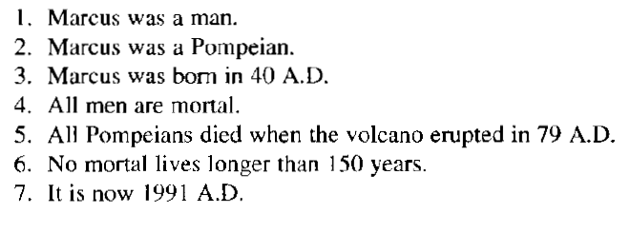
Is a good solution absolute or relative?
Consider the simple facts shown on the right.
Question is asked “Is Marcus alive?”
Several ways of deciding that Marcus is dead.

Slide 34
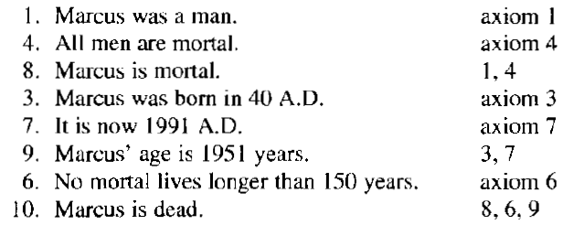
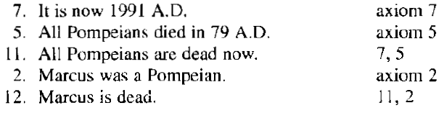
Two ways are…

Slide 35
But in case of TSP the shortest route is the only solution to the problem.
Thus reasoning problem is an example of any path problem whereas TSP is an example of best path problem.

Slide 36
What is the role of knowledge?
For playing chess a limited amount of knowledge is required for determining the legal moves and implementing simple control mechanisms.
But for determining which newspapers support which candidates in the elections a lot of knowledge is required even for recognizing the solution.

Slide 37
Does the task require interaction with a person?
Consider the problem of proving mathematical theorems. If
1. All we want to know that there is a proof.
2. The program is capable of finding a proof by itself.
then it does not matter what strategy the program takes to find the proof.
Alternatively finding the proof may be sufficiently difficult so that the program does not know where to start from.

Slide 38
There are thus two classes of problems:
Solitary, in which the computer is given a problem description and produces an answer with no intermediate communication.
Conversational, in which there is an intermediate communication between a person and a computer for providing additional assistance.

Slide 39
Issues in the design of search program
Direction of search: forward vs. backward reasoning (Initial to goal state or vice versa).
How to select appropriate matching rules (Importance of search procedure).
How to represent each node in the search process (Knowledge representation problem and the frame problem).

Slide 40
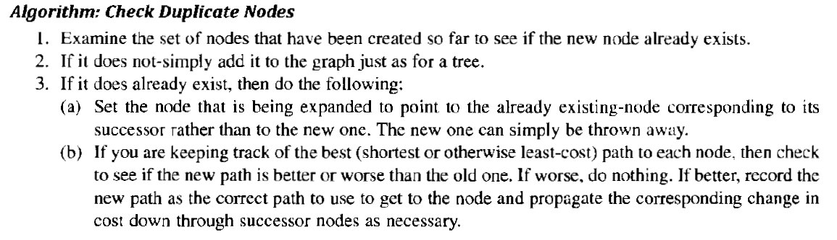

Slide 41
